Slide 1
Web applications, web design, web development
/* Martin Macura :-} */

Slide 2
HTML
HyperText Markup Language
Used since: 1993

Slide 3
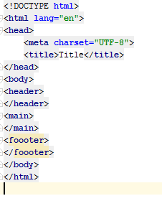
Every page needs...
HTML
Head
Basic info
Styles
srcipts
Body
Header
Main
Footer

Slide 4
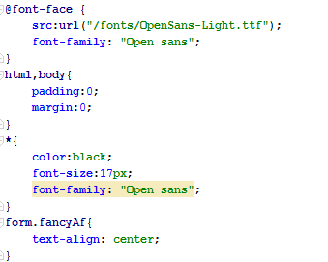
Cascading Style Sheets
Style the elements
Classes, ids, element types

Slide 5
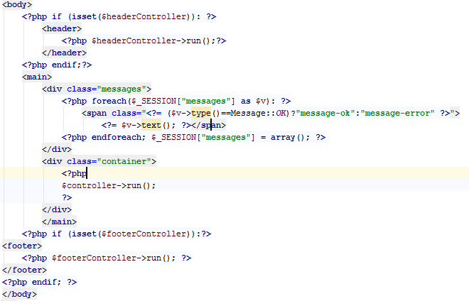
Web design vs. Web development
Front-end vs. back-end
Front-end - HTML, CSS, JS
Back-end – PHP, JAVA, ASP.NET, NODEJS

Slide 6
Business websites
Depends on what the company wants do display
Applications vs. Just latest news and some basic info

